Slide 1
Applications of AI and ML in real world
March 2, 2020
Inlustro

Slide 2


Dinesh Kumar P
Product Manager,
Reports & Analytics Squad,
https://www.linkedin.com/in/dinesh-kumar-prabakaran
Notes:
Coming through 8+ years of journey around data space, I was deeply involved implementing B2B SaaS products for Big Data, ETL and Business Intelligence. Currently as a product manager, I take care of the analytics and reports squad at company called Kissflow. Here he would share his knowledge with his experience about his journey in data space and about the basics of AI and ML.

Slide 3

Agenda
My journey in Data Space.
Jobs around DATA.
Machine Learning and Artificial Intelligence in a general / layman language.
Evolution of No code/ Low code platforms for ML.
Demo using ML.Net Model Builder.

Slide 4

What quality / skill enables some people get a higher pay?
₹ 2,00,000
₹ 1,00,000
₹ 75,000
₹ 50,000
Notes:
Let me ask a simple question. For what basic skill, different people get different salary? Perhaps that is the same basic thing which all the ML or AI projects are solving and make our life easier.

Slide 5


Decision Making skill
Notes:
Its DECISION MAKING. And that’s what AI is doing for Humans right? I can say many real time examples for this. For now, lets take - the Google Maps. Before 5 years, if you are riding to a destination for which you don’t know the route, you will constantly ask the persons who are on your path way, think over the route and go on. But now, Google Maps in our mobile phone, decides and tells this is the right route. And we are travelling just by looking into that Map path. Notice that here decision making work is partially taken over by the software comparing to the same situation before 5 years.
Software are no more just software. As engineers, we are making them as intelligent agents and make them evolve as more human in nature. Simply say, future machines with software will slowly rise to the conscious level of humans even!

Slide 6
Every progress in a work Driven by decision making
Programmer decides,
If branch (or)
Switch statement
Business man decides,
More discount (or)
Kind words

Slide 7
My job journey around data
UG – Passionate about understanding data model. DFD and ER diagram.
PG – Build a POC by myself.
Big Data IDE product.
Big Data Cluster Manager product.
ETL product.
Business Intelligence product.
Analytics module of Kissflow.

Slide 8
Career around DATA
Can you plan the backend for this app / project? - Data Architect.
What kind of environment should I setup? – Big Data Admin / DataOps
How raw data be processed to create prepared data via ETL? – Big Data Developer / Data Engineer
Identify Combinations of prepared data and machine learning algorithms should you use to create the best model? – Data Analyst / Data Scientist.
All these analysis as dashboard / report for decision making. – Business Intelligence specialist.
Notes:
I would like to call it as a Career than “JOB”

Slide 9
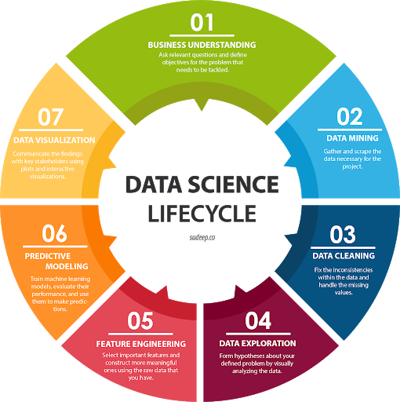
Data career landscape

Slide 10
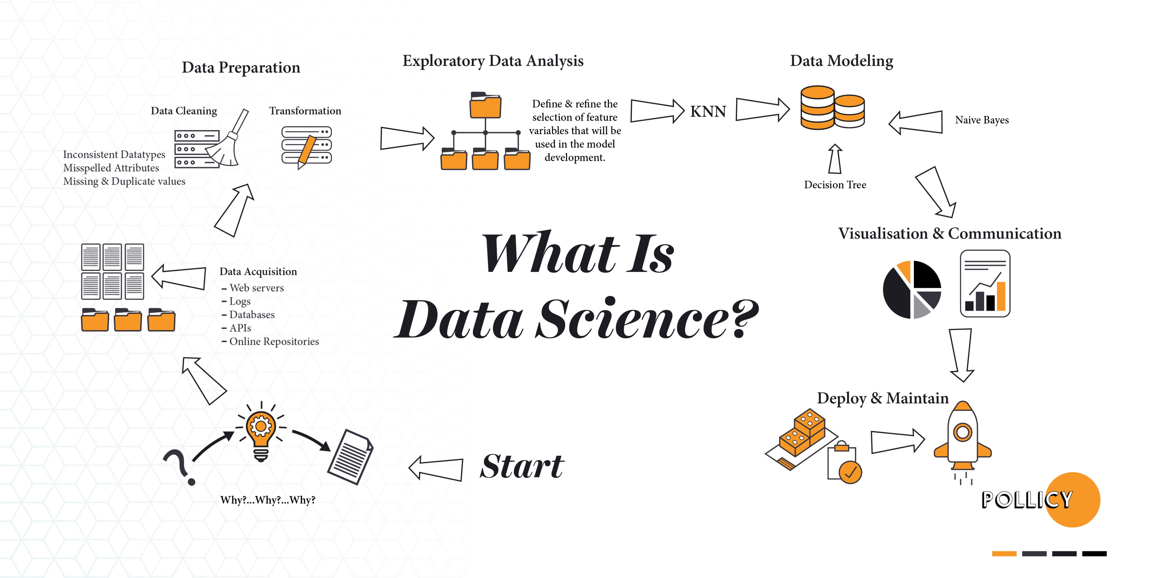

Slide 11
Primary skillset for any role in Data
SQL
Communication
Understand the Domain (Industry / Department)

Slide 12
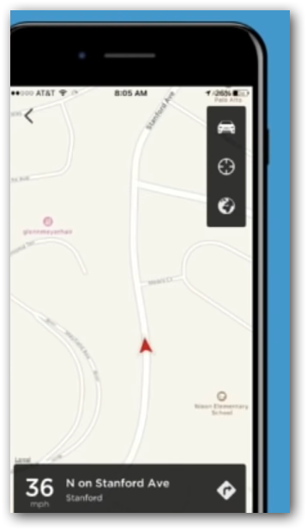
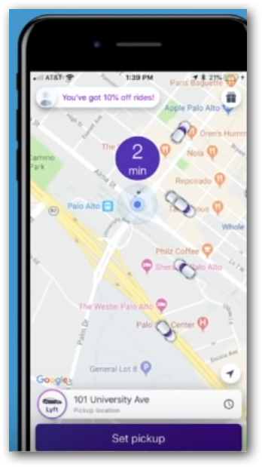
Which one a user would Like?
Where is my driver?
Just real time.
When will my driver get here?
Real time combined with historical data.
The Business (winning) touch.
Notes:
Data science – With the history of gbs or tbs of trip data, bring up some fact / model that can predict the approximate time
Big Data – Use that model in each and every trip and show the value to user. i.e. Real VALUE that a customer expect.

Slide 13
Features make humans different from machines
Taste,
Odour,
Thought,
Vision,
Speech,
Hear
Feel

Slide 14
Nowadays you can see these in Machines
Thought,
Vision,
Speech,
Hear
Notes:
Data Scientists and Machine Learning Engineers are working hard to recreate the sense of thought, hearing, speech and vision in machines. In the upcoming hour all we are going to see is around these features.

Slide 15
Examples

Slide 16
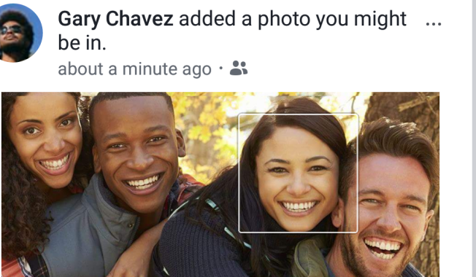
Thought
Facebook recognize faces like a human and suggests auto-tag while uploading a picture.

Slide 17
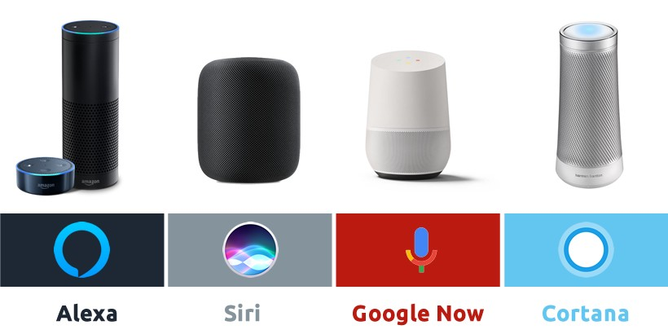
Hear & Respond
Google Assistant
Alexa
Siri
Notes:
Natural Language Processing

Slide 18
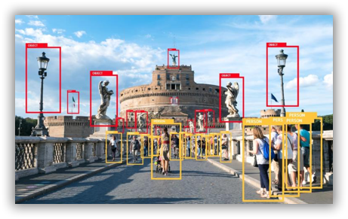
Vision
Surveillance
Capturing traffic violations

Slide 19
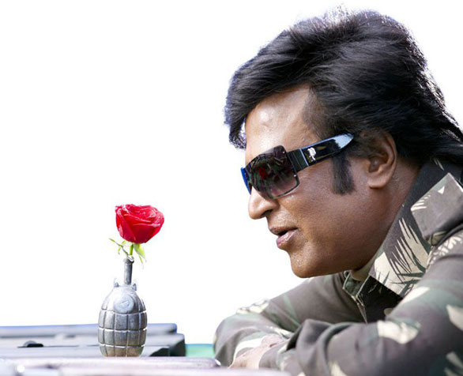

Feel

Slide 20
Human’s features into machines. WHY?

Slide 21
Machines match or overtake human intelligence?
Impossible actions like Rescue missions.
Accuracy – Consistent and Known level.
Speed.
Notes:
Machines match or overtake human intelligence.
- Rescue missions – Bore well, Mines.
-
- Consistent and Known Accuracy.

Slide 22
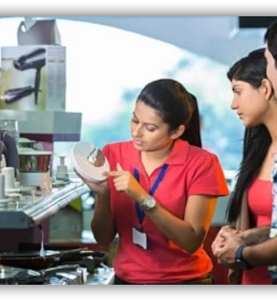
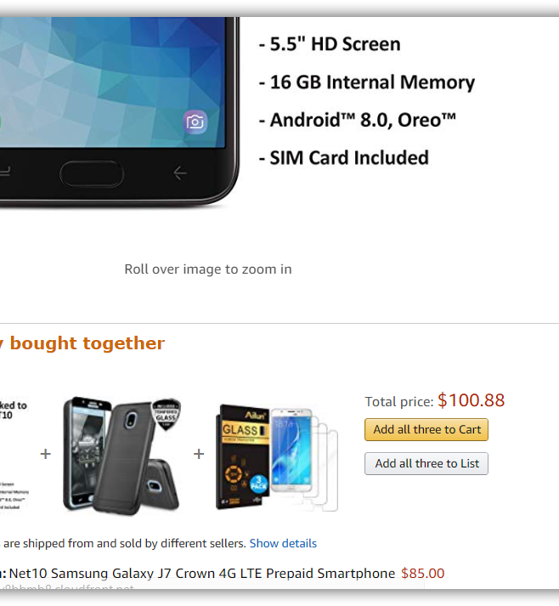
Notes:
Question:
The right side image - Where do you see such a thing?
Human may get tied. Vary in the process at times / situations. (Morning fresh, Evening tied)
Machines always perform as 100% until it is given the electricity power.

Slide 23
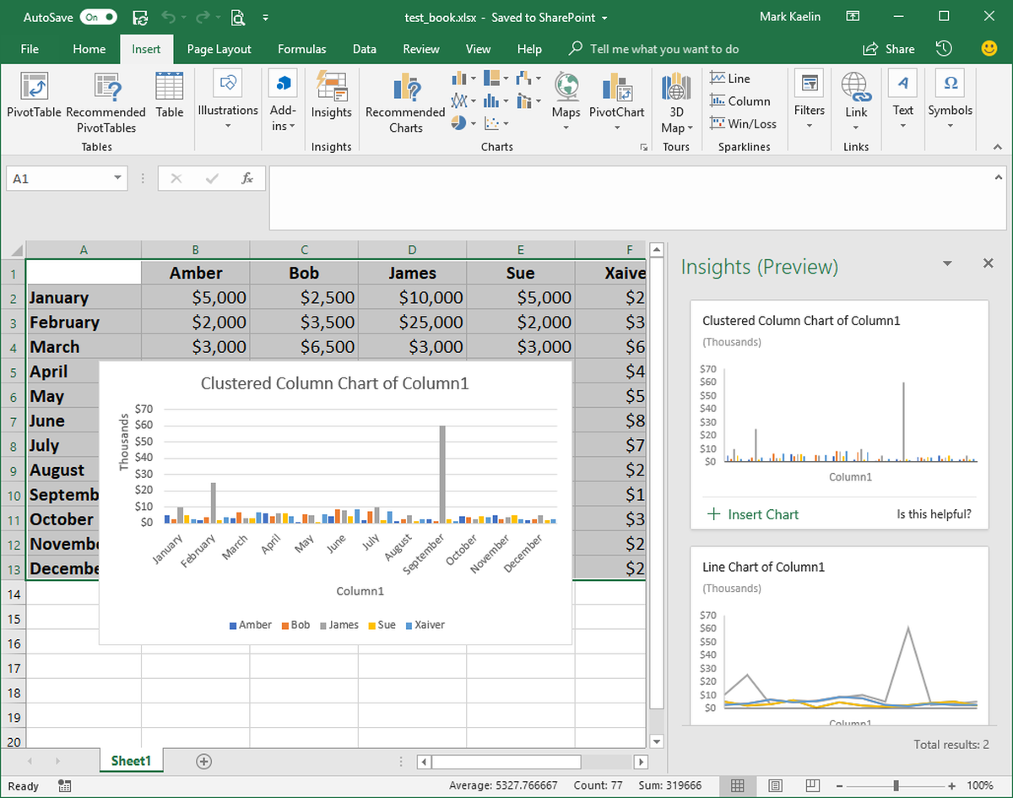
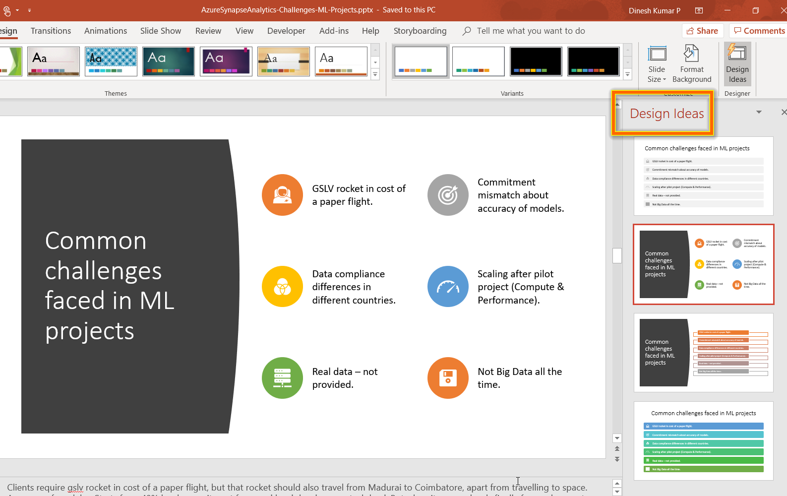
Excel
PowerPoint
Notes:
AI is everywhere. As you see in the slide,
‘Design Ideas’ in PowerPoint suggests you good designs and icon sets for the content, in a fraction of second than a human can think.
‘Ideas’ in Excel, automatically decides the suitable chart based on the data you have and populates it right inside of the Excel app automatically.
‘Insights’ in outlook lets you know, if anything you have promised is getting missed out without addressing it.

Slide 24
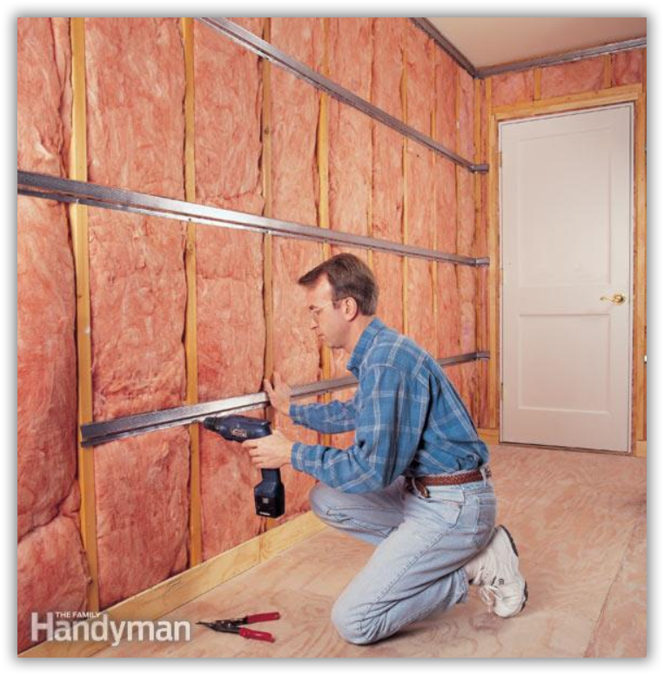
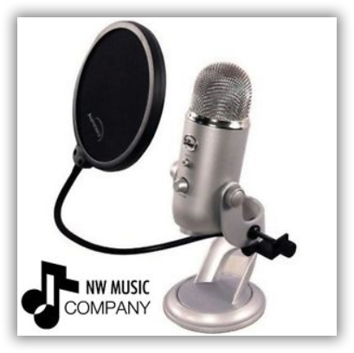
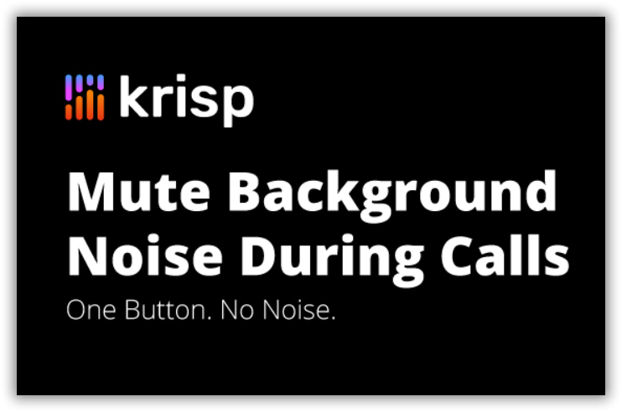
Machines match or overtake human intelligence?
BIAS against AI taking up jobs
Notes:
How many of you create YouTube videos here?
What do you do for recording a noise free video?
To record tutorial videos, in my own company we were evaluating multiple options. The left most – Sound proof room, Center – Noise cancelling MIC, Right – You could see a software that does all noise cancellation works.
Guess what we choose? It’s the noise cancelling software. It was way cheaper with our expected Quality. Now should I or my company think that did we make lose a job of a worker or a made loss for company who sell that MIC? Weird na?

Slide 25
Can you Answer?
Can you name one or both MS Office App and its AI feature?
Notes:
Decision Making

Slide 26
Can you Answer?
4 features of humans nowadays we can see in machines?
Notes:
Thought, Vision, Speech, Hear

Slide 27
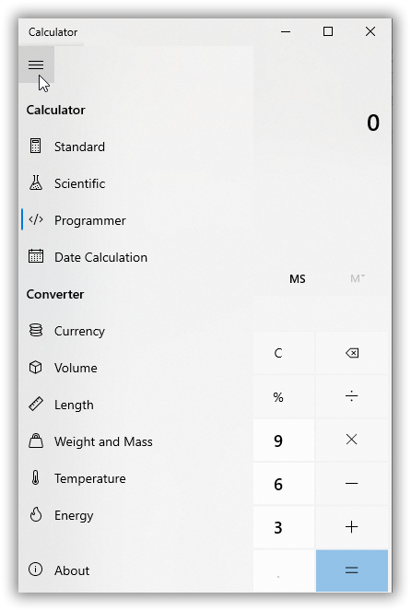
Notes:
Question:
Calculator has a lot of features. Its fast, efficient than most of the humans. So is this another example for Artificial Intelligence like previous chess game?
NO. Calculators do not have decision making abilities. So you cannot consider calculator as a AI device.

Slide 28

Notes:
Played HUMAN vs COMPUTER chess game? We Human will be efficient at times and not some times. But the opponent Computer wont get tied any number of times you play.

Slide 29
Can you Answer?
For what quality some people get a higher pay?
The same basic quality is that we try to incorporate into machines?
Notes:
DECISION MAKING

Slide 30

AI & ML

Slide 31
What is Machine Learning ?
A program that looks for patterns in existing data.
Recognize those pattern in new Data

Slide 32
What Machine Learning do?
Predicting future
Organizing or Grouping

Slide 33
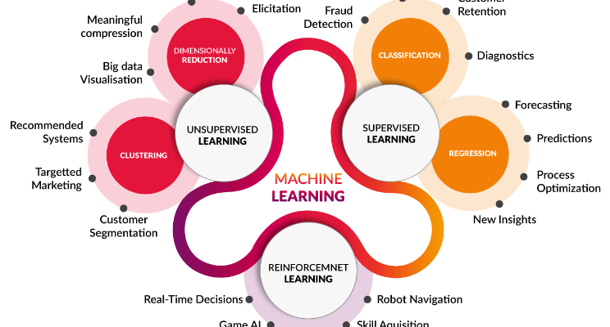
Algorithms

Slide 34
Five Questions to cover algorithms
1. Is this A or B ?
2. Is this Weird ?
3. How much effective or many ?
4. How this should be organized ?
5. What should I do next ?
Notes:
Classification.
Anomaly Detection.
Regression.
Clustering.
Reinforcement.

Slide 35
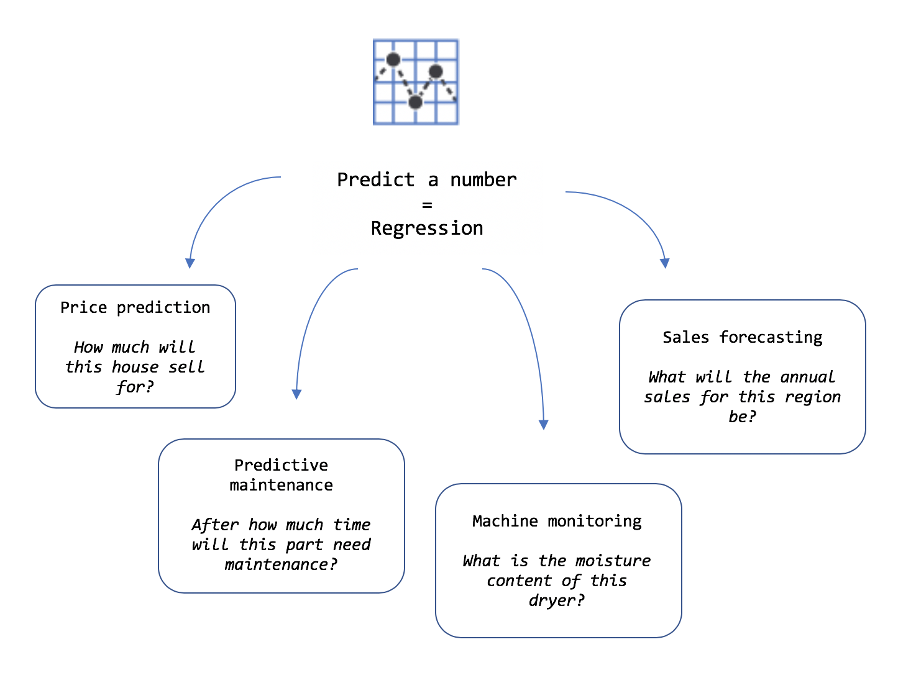
Clear about the requirement

Slide 36
Can you Answer?
ML Algorithm for this scenario.
Is this a Bike or Bicycle?
Notes:
Classification algorithm. Since there are only 2 options – Its Binary Classification

Slide 37
If you know the problem well, figuring solution is as simple as it is.
Defining problem is 80%
Solution is just 20%

Slide 38
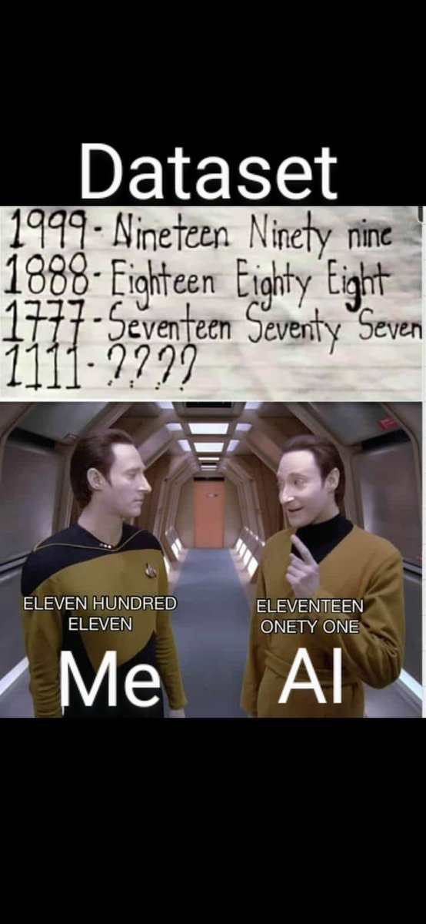
Just training alone enough?

Slide 39
Confusing an ML model
Actual image and a broken image.
Looks same in human eye.
But a model will fail to recognize that both are same.

Slide 40
No/Low Code dev platforms
Problems better solvable by industry / business people like citizen data scientist.
DIY – Do It Yourself mindset.
Adobe Photoshop vs Canva.
Notes:
I hope you know tools like Canva. Such Tools are not so famous 10 years back. Late then, if any image editing work is needed, it was Photoshop and someone who learnt it very well is needed. But now, no code tool like Canva has made it possible to create a banner so easily. That's the case of ML.Net model builder as well. Currently the adoption to production environment is mostly on enterprise level. But in a while Machine Learning will become essential for any application.

Slide 41
Why no-code / low-code important for companies now?
Attain growth faster with small, lean & remote workforce.
Fail fast.
By the year 2024 65% of app development and 66% of companies would use 4 low-code tools & platforms.

Slide 42
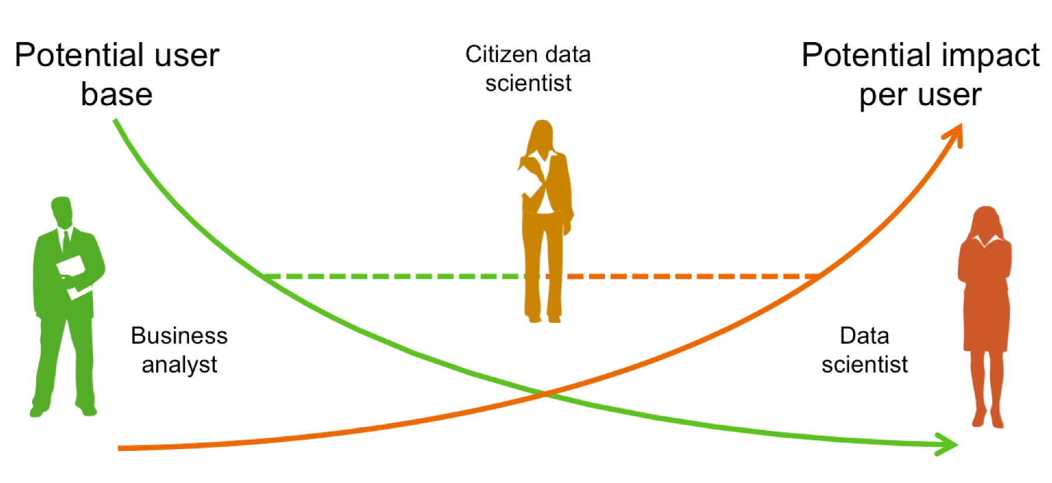
Democratization in Data Gaps are getting reduced
Notes:
Problem owners can drive the solution better and faster. The gaps will be reduced.

Slide 43
Machine Learning Model
A machine learning model is a file or think as a piece of software.
Trained to recognize certain types of patterns.
You train a model over a set of data, providing it an algorithm that it can use to reason over and learn from those data.

Slide 44
Pre-trained model vs prepare a ML model
Different businesses have different sense of data.
Specific problems relevant to individual business should be able to solve better by those business users.
Feedbacks of Movie, E-Commerce retail shopping website, Food ordering app may not be same type to categorize as good / bad.
Notes:
There are pre-trained models available that can be used in few button clicks.

Slide 45
ML.Net
Open source cross-platform machine learning framework.
Auto ML made easy to play via Model Builder with GUI.
Not required much expertise in ML.

Slide 46
Where does ML.Net fits in Machine Learning landscape?

Slide 47
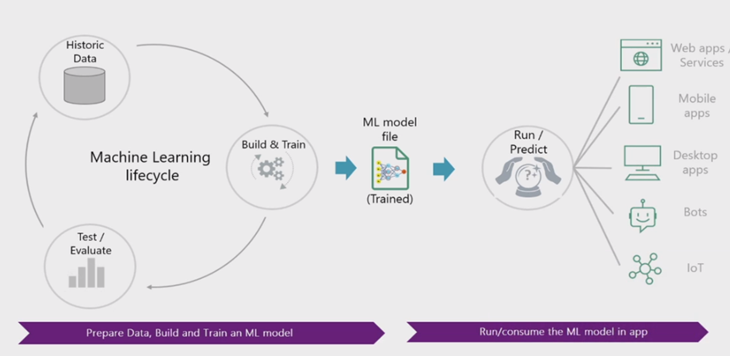
ML.Net
Notes:
Microsoft has decided to make Machine Learning accessible to .NET developers through ML.NET. ML.NET API is very simple and easy to learn. You can forget about large mathematical equations and implementations of algorithms.
Diagram show the process of building models using ML.NET.
1. Prepare your data. 2. Decide the algorithm to use. 3. Train a model using the selected algorithm. 4. Evaluate the model. 5. Save the model. 6. Use the saved model in your .NET applications.

Slide 48
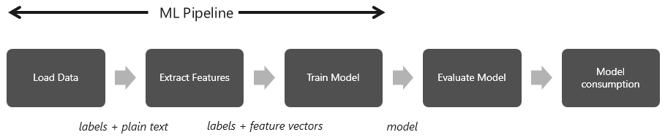
ML Pipeline Think as a water pipeline from river to your home

Slide 49
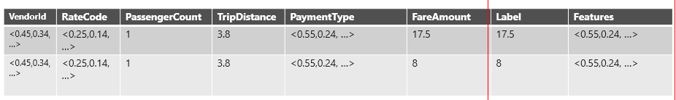
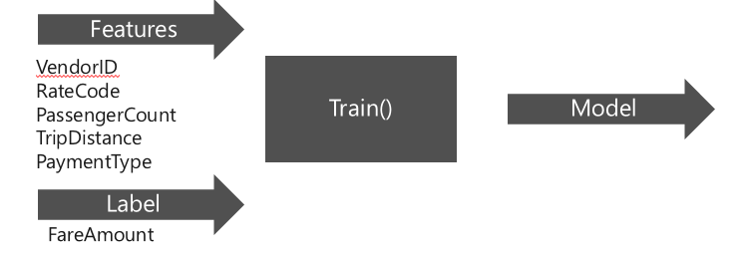
Features and Label(s) Uber’s taxi fare example
Notes:
Change the column names

Slide 50
My Use Case for ML.Net Model Builder
Goal: Recognize the sentiment of feedback text with 3 rating.
Reason: 1,2 rating mostly will have worst comment. Similarly 4,5 will have good comments. Feedbacks with 3 rating is annoying and yet to predict.

Slide 51
1. Train the model with same customer data with 1, 2, 4 and 5 ratings
2. Test the model
3. Use the model to check comments of 3 rating, where it fits in – 1, 2, 3 or 4
4. Pipeline to retrain the model in future

Slide 52
ML.Net Demo

Slide 53
Resources
Learning programming languages in Tamil – Python
Books
Cartoon Introduction to Statistics
Thinking Fast & Slow by Daniel Kaheman
Art of thinking clearly – Rolf Dobelli

Slide 54



Thank you! Questions?
https://www.linkedin.com/in/dinesh-kumar-prabakaran

